Slide 1

Target Market: Every individual and all websites related to medical field
Value Propositions:
We will be using the twitter API to get the posts related to COVID-19 from users and then we performed sentiment analysis on these collected posts to get the general idea of how every individual is affected by the covid crisis and how they are responding.
Co-Founders:
Ankush Bosi
Hardhika Venkatesan
Kesava Karri
Rahul Katamneni
Ramesh Tripuraneni

Slide 2
THE PAIN WE ARE ADDRESSING
The records published by government or media are not necessarily need to be true
Inadequate accuracy and performance in sentiment analysis
Individual response over certain region
People are afraid to travel because of covid in that region
Event organisation

Slide 3
FIXING THE PROBLEM WITH AI OR COMPUTER TECHNIQUES
Twitter has always been a platform where people come together to put forth their opinions and thoughts.
Raw data obtained from twitter using twitter API is filtered using machine learning packages.
The current global concern is COVID-19 and this has led to a tremendous uproar of tweets related to the pandemic.
The large amounts of tweets produced, provide us the opportunity to analyze the tweets for all possible information from people's activity and involvement to how the people are emotionally affected by the pandemic.

Slide 4
KEY WINNING FEATURES
The competitors are Rapid miner, Confirmit, IBM Watson Studio.
Stream Twitter API for live updates.
Sentiment and Emotion analysis of tweets.
Location Plot of Tweets.
Interactive and Intuitive Dashboard.
End-to-end application deployed on Cloud.

Slide 5
CAPABILITIES
Authentication of data
Frequent data fetching
Data redundancy
Polarity Distribution

Slide 6
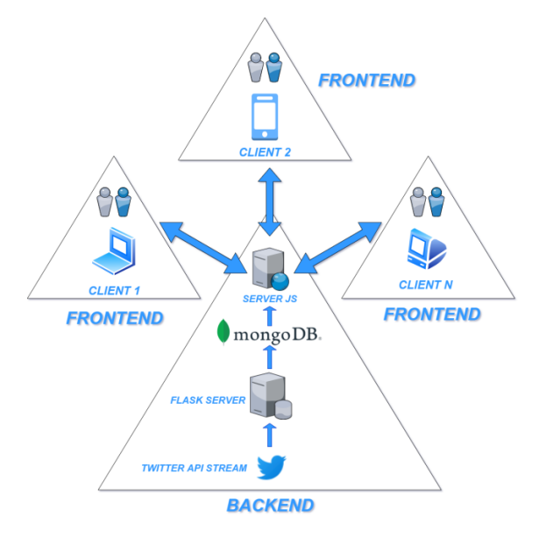
JUSTIFICATION
We will be using the twitter API to get the posts related to COVID-19 from individuals and then we will be performing sentiment analysis on these collected posts to get the general idea of how individuals are affected by the crisis and how they are responding.

Slide 7
Current Status and Initial Prototype
Dashboard with three categories which are
Mapbox
Sentiment vs time graph
Subjectivity vs time graph
Current dashboard in working model is
Thermograph
Sentiment vs time graph
Subjectivity vs time graph
Polarity distribution

Slide 8
Business Model & Marketing Strategies
Social media marketing – LinkedIn, Instagram ads, Google ads
Monetization
Developing dedicated app for iOS and Android in future

Slide 9
Team Expertise
Keshav Karri
Full Stack Web Developer
Ankush Bosi
Cloud Architect
Ramesh Tripuraneni
Marketing Specialist & Backend
Rahul Katameneni
Front End Developer
Hardhika Venkatesan
NLP Engineer

Slide 10
Plan for Implementation, Technical Validation, Market-Entry and Scale-Up
Planned to design an intuitive dashboard
Data fetching
data pre-processing
creating backend, designing frontend
Deployment
We’re planning to develop a web application

